Slide 1
Working with Lists

Slide 2
Objectives
In this session we will:
Understand and use For Loops
Use the Range function
Use some more list functions
Slice and Copy lists
Understand Tuples vs. Lists
Notes:
#this is an example of using a for loop
cats = ['weasley', 'noche', 'mr. bigglesworth', 'justin']
for cat in cats: #this begins or defines the for loop. This tells Python to store a name from the list into the variable ‘cat’
print(cat)
#think of this as - for every cat in the list of cats, print the cat’s name

Slide 3
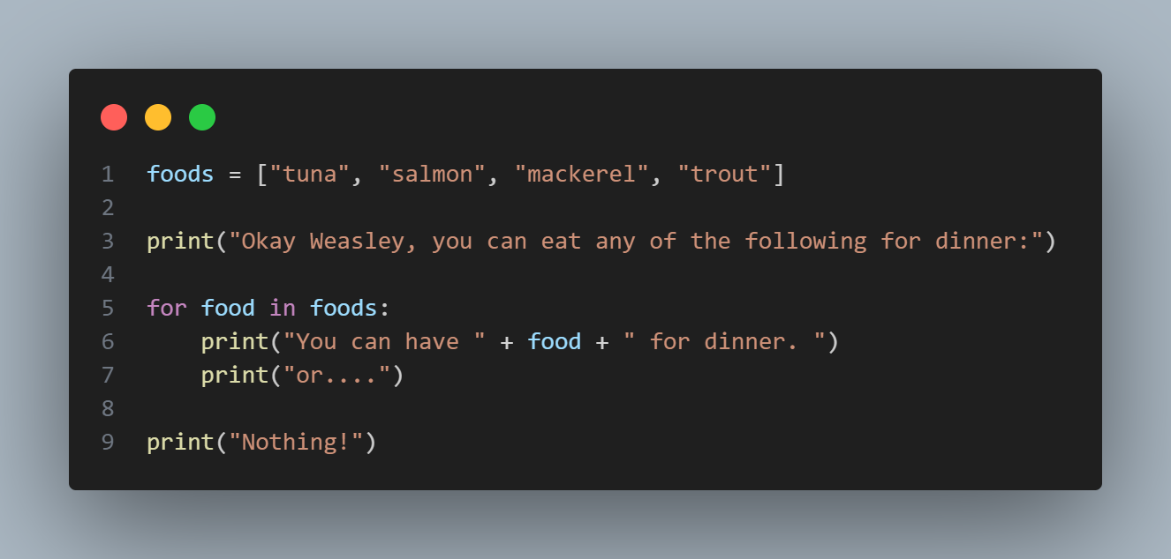
Notes:
foods = ["tuna", "salmon", "mackerel", "trout"]
print("Okay Weasley, you can eat any of the following for dinner:")
for food in foods:
print("You can have " + food + " for dinner. ")
print("or....")
print("Nothing!")

Slide 4
For Loops
A for loop is used for iterating over a sequence
What Python will do is loop through each of the items in the list that you have provided, rather than accessing each item in the list individually.
Remember your colon (:)!!
Basic syntax:
for <each item> in <list of items>:
indent <code to run on each item>
indent <more code to run on each item>
Notes:
#this is an example of using a for loop
cats = ['weasley', 'noche', 'mr. bigglesworth', 'justin']
for cat in cats: #this begins or defines the for loop. This tells Python to store a name from the list into the variable ‘cat’
print(cat)
#think of this as - for every cat in the list of cats, print the cat’s name

Slide 5
Notes:
foods = ["tuna", "salmon", "mackerel", "trout"]
print("Okay Weasley, you can eat any of the following for dinner:")
for food in foods:
print("You can have " + food + " for dinner. ")
print("or....")
print("Nothing!")

Slide 6
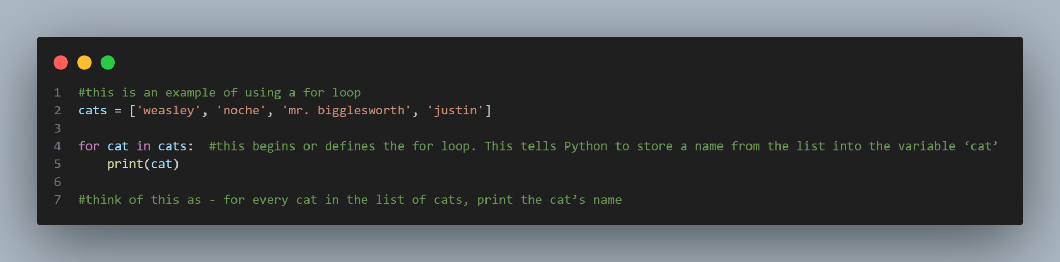
Another example…
Notes:
#this is an example of using a for loop
cats = ['weasley', 'noche', 'mr. bigglesworth', 'justin']
for cat in cats: #this begins or defines the for loop. This tells Python to store a name from the list into the variable ‘cat’
print(cat)
#think of this as - for every cat in the list of cats, print the cat’s name

Slide 7
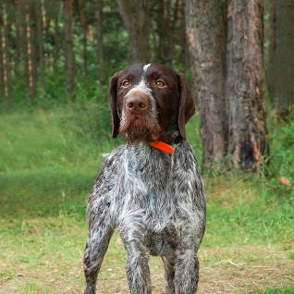
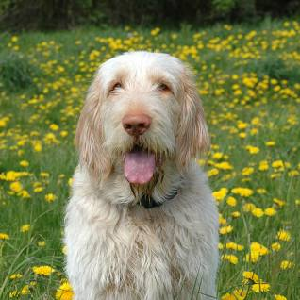
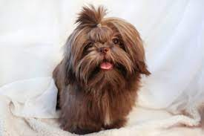

Another Example…
Notes:
#Another example of for loops
#think of this as - for each dog in the dogs list, print their name. Python will loop through each dog in the list and print their name.
dogs = ['frankie', 'otto', 'daisy', 'flossie']
for dog in dogs:
print(dog)

Slide 8
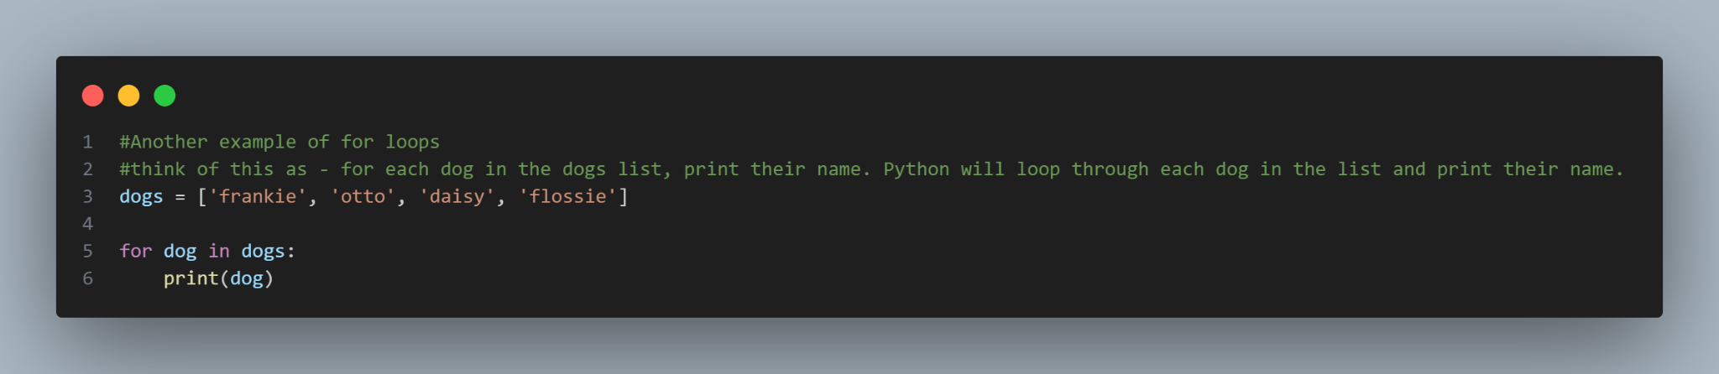
Notes:
#Another example of for loops
#think of this as - for each dog in the dogs list, print their name. Python will loop through each dog in the list and print their name.
dogs = ['frankie', 'otto', 'daisy', 'flossie']
for dog in dogs:
print(dog)

Slide 9
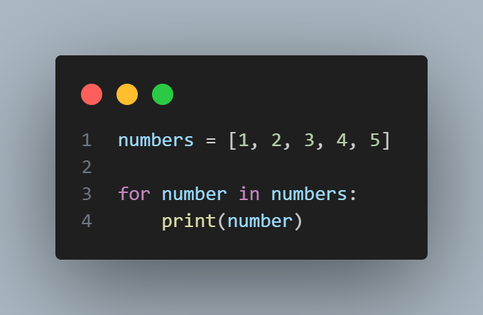
Making Numerical Lists
Cats and dogs aside, sometimes you might need to make lists using numbers. To make a list using numbers, you do exactly what you have seen with our list of cats:
Notes:
numbers = [1, 2, 3, 4, 5]
for number in numbers:
print(number)
But you can do so much more with numbers and lists!

Slide 10
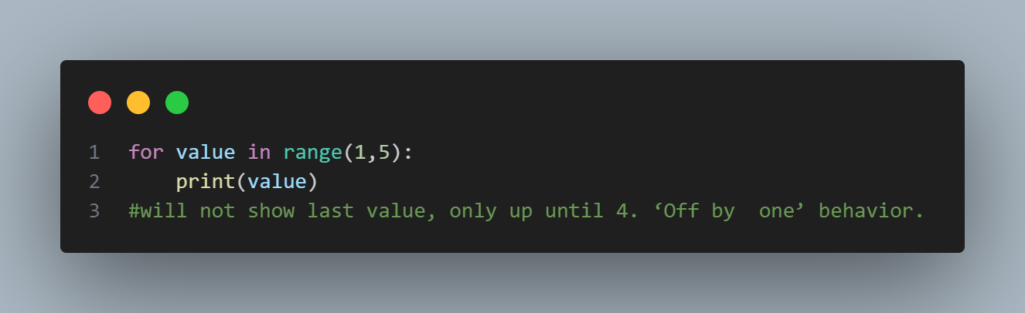
range() function
-Python’s range() function makes it easy to generate a series of numbers within a given range of numbers you provide.
Notes:
for value in range(1,5):
print(value)
#will not show last value, only up until 4. ‘Off by one’ behavior.

Slide 11
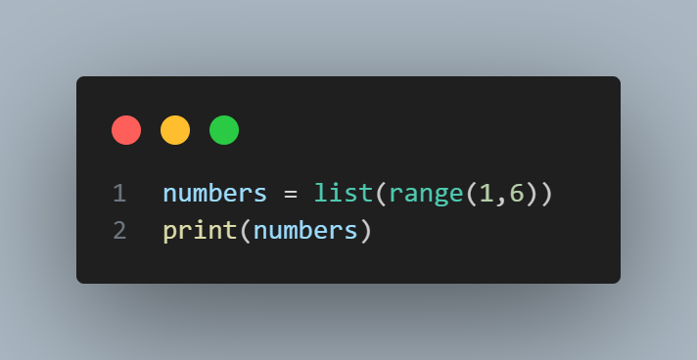
range() and listing numbers
If you want to make a list of numbers, you can convert the results of range() directly into a list using the list() function. When you wrap list() around a call to the range() function, the output will be a list of numbers.
Notes:
numbers = list(range(1,6))
print(numbers)

Slide 12
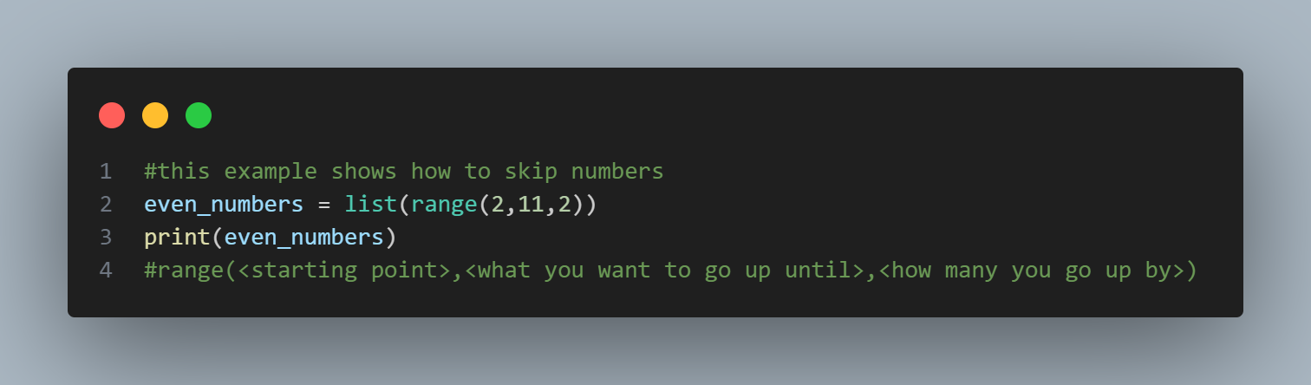
range() and list()
You could even use these functions to skip numbers in a given range!
Notes:
#this example shows how to skip numbers
even_numbers = list(range(2,11,2))
print(even_numbers)
#range(<starting point>,<what you want to go up until>,<how many you go up by>)

Slide 13
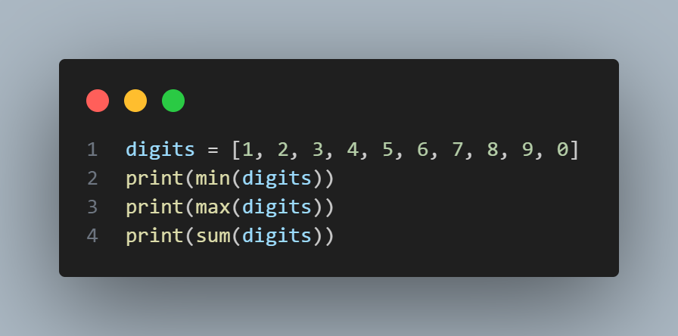
Finding min, max, and sum of digits
You can also review a number of available list methods here
Notes:
digits = [1, 2, 3, 4, 5, 6, 7, 8, 9, 0]
print(min(digits))
print(max(digits))
print(sum(digits))

Slide 14


Back to our teaching assistants!

Slide 15
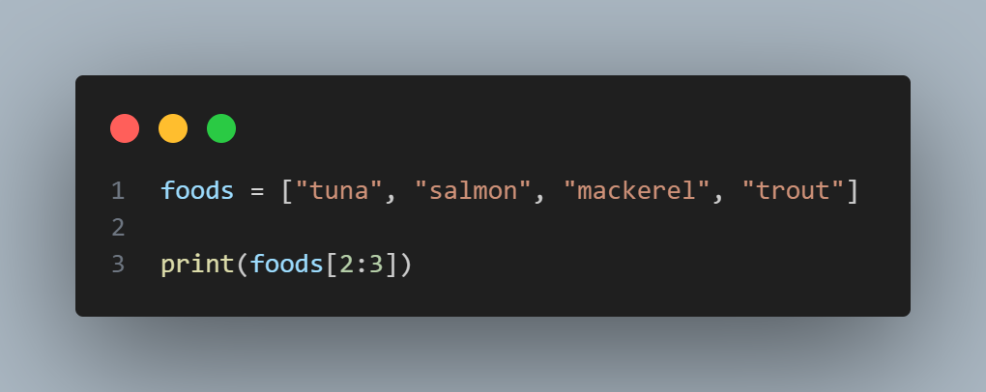
Slicing a list
-To make a slice, you specify the index of the first and last elements you want to work with.
Notes:
foods = ["tuna", "salmon", "mackerel", "trout"]
print(foods[2:3])
#this is an example of slicing a list
plants = ['hawthoria', 'palm', 'pothos', 'barrel cactus', 'prayer plant']
print(plants[2:3])

Slide 16
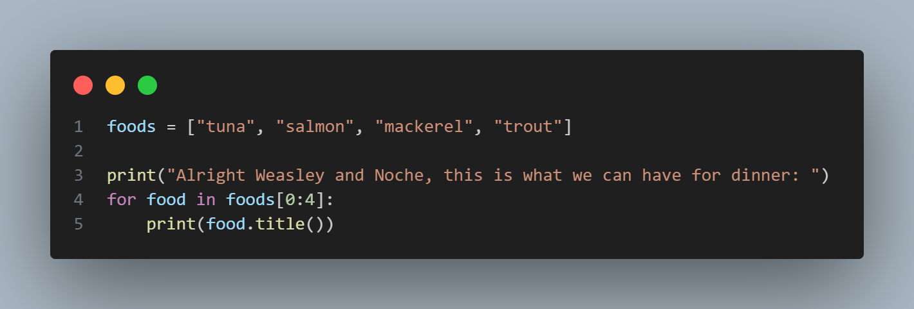
Looping Through a Slice
You can use a slice in a for loop if you want to loop through a subset of the elements in a list
Notes:
foods = ["tuna", "salmon", "mackerel", "trout"]
print("Alright Weasley and Noche, this is what we can have for dinner: ")
for food in foods[0:4]:
print(food.title())
plants = ['hawthoria', 'palm', 'pothos', 'barrel cactus', 'prayer plant']
print("Here are my favorite plants out of my list:")
for plant in plants[0:4]:
print(plant.title())

Slide 17
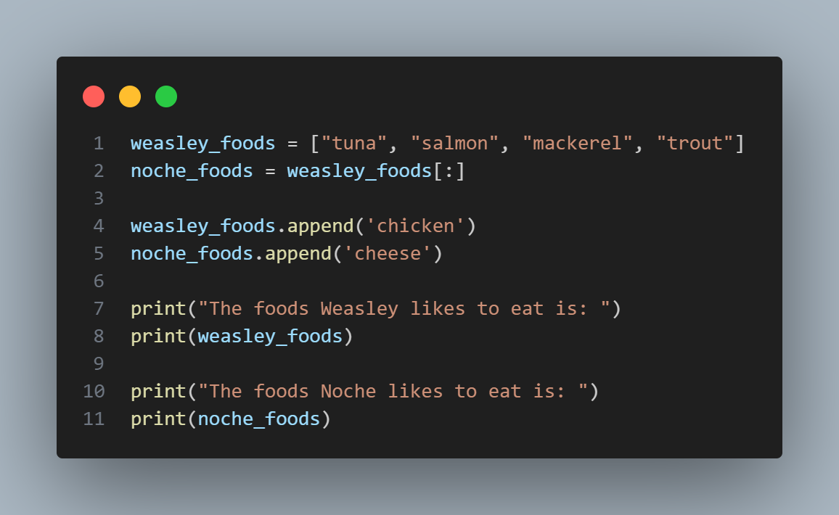
Copying a List
To copy a list, you can make a slice that includes the entire original list by omitting the first index and the second index ([:]). This tells Python to make a slice that starts at the first item and ends with the last item, producing a copy of the entire list
Notes:
weasley_foods = ["tuna", "salmon", "mackerel", "trout"]
noche_foods = weasley_foods[:]
weasley_foods.append('chicken')
noche_foods.append('cheese')
print("The foods Weasley likes to eat is: ")
print(weasley_foods)
print("The foods Noche likes to eat is: ")
print(noche_foods)
my_foods = ['pizza', 'falafel', 'carrot cake']
friend_foods = my_foods[:]
my_foods.append('cannoli')
friend_foods.append('ice cream')
print("My favorite foods are:")
print(my_foods)
print("\nMy friend's favorite foods are:")
print(friend_foods)

Slide 18
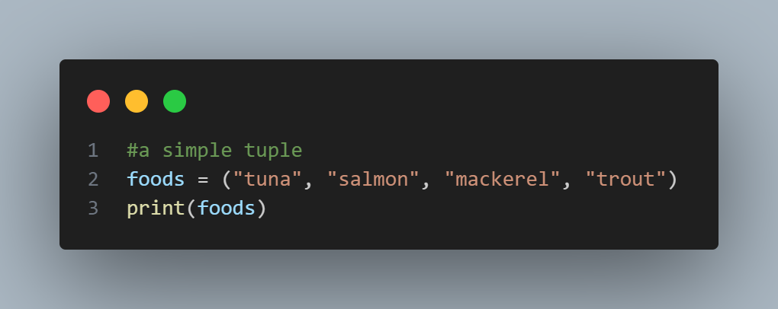
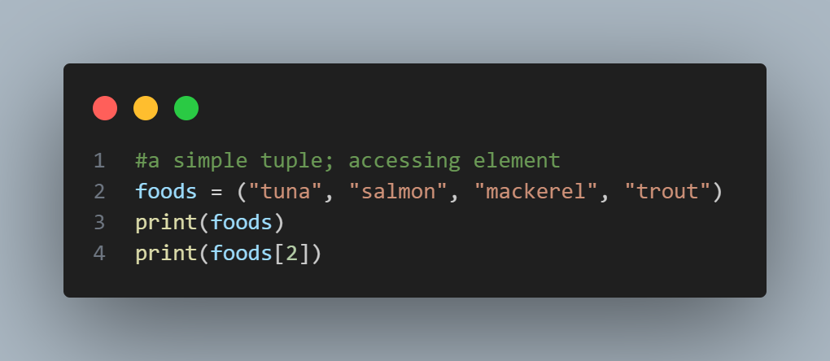
Tuples
A tuple looks just like a list except you use parentheses instead of square brackets.
The reason why you use this - if you want to list things out but not change it. Think about a permanent menu option that you always want to keep up.
Tuples are known as the immutable lists, or a list that cannot change.
Notes:
#a simple tuple
foods = ("tuna", "salmon", "mackerel", "trout")
print(foods)
#a simple tuple; accessing element
foods = ("tuna", "salmon", "mackerel", "trout")
print(foods)
print(foods[2])
#defining a simple tuple
plants = ('cacti', 'pothos', 'eucalyptus')
print(plants)
#accessing an element in a tuple is the same as accessing one in a list
plants = ('cacti', 'pothos', 'eucalyptus')
print(plants[0])

Slide 19
Redefining the Tuple
Although you cannot change the elements in a tuple, you can assign a new value to a variable that represents a tuple.
Use them if you do not want the values to changes throughout the life of a program.
Notes:
plants = ('cacti', 'pothos', 'eucalyptus')
for plant in plants:
print(plant)
plants = ('palm', 'tree', 'lily pad')
for plant in plants:
print(plant)
print(plants)

Slide 20
Notes:
foods = ["tuna", "salmon", "mackerel", "trout"]
print("Okay Weasley, you can eat any of the following for dinner:")
for food in foods:
print("You can have " + food + " for dinner. ")
print("or....")
print("Nothing!")
Now, make this your own! Try and use the concepts we have learned in this session to recreate my code. When you finish, post your code to the Slack!

Slide 21
Up next… Complete exercise 4: Working with Lists!
TIFC1-PF-4 - Working with Lists - Tasks

